Slide 1
skripsi Implementasi Algoritma Neural Network untuk Prediksi Penyakit Diabetes

Slide 2
Perkenalkan saya
Rizkyandy Wibowo
NIM: 191011400278
Universitas Pamulang
Fakultas Ilmu Komputer, Teknik Informatika

Slide 3
Pendahuluan
Diabetes adalah penyakit kronis yang ditandai dengan kadar glukosa darah yang tinggi.
Salah satu metode yang digunakan untuk mendeteksi diabetes adalah dengan menggunakan Neural Network.
Neural Network dapat membantu dalam analisis dan prediksi data dengan tingkat akurasi yang tinggi.

Slide 4
Latar Belakang
Diabetes adalah penyakit kronis yang ditandai dengan kadar glukosa darah yang tinggi.
Salah satu metode yang digunakan untuk mendeteksi diabetes adalah dengan menggunakan Neural Network.
Neural Network dapat membantu dalam analisis dan prediksi data dengan tingkat akurasi yang tinggi.

Slide 5
Metode penelitian
Pengembangan Model: Neural Network menggunakan TensorFlow atau Keras
Pelatihan dan Pengujian: Menggunakan dataset diabetes yang dibagi menjadi data pelatihan dan pengujian.
Pengembangan Aplikasi Web: Untuk mengintegrasikan model Neural Network dan memudahkan penggunaan.

Slide 6
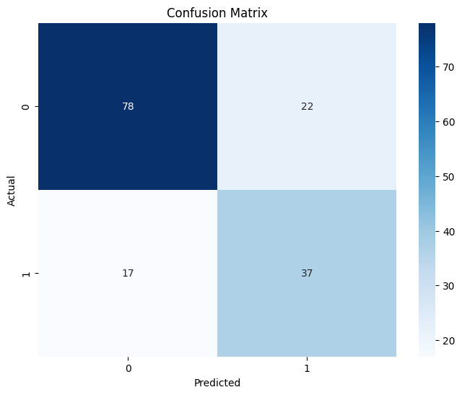
Hasil penelitian
Model Neural Network yang dikembangkan memiliki akurasi sebesar 78.9%
Keberhasilan ini menunjukkan potensi Neural Network dalam deteksi diabetes.
Pengujian menunjukkan bahwa model memiliki ketahanan yang baik terhadap perubahan data.
Model | Hasil
Akurasi | 78.9%
Recall | 78.5
F1-Score | 77.6

Slide 7
Kesimpulan
50%
75%
Neural Network terbukti efektif dalam meningkatkan akurasi deteksi diabetes.
Aplikasi web yang dikembangkan memudahkan tenaga medis dalam memprediksi risiko diabetes.
Masih diperlukan pengujian lebih lanjut dengan data yang lebih bervariasi untuk meningkatkan akurasi.

Slide 8
saran
Melakukan uji klinis lebih lanjut untuk validasi medis.
Pengembangan versi aplikasi yang lebih luas untuk meningkatkan aksesibilitas.
Kolaborasi dengan institusi medis untuk integrasi lebih lanjut dalam praktik klinis.

Slide 9
referensi
Sapitri, M.D., & Hartono. (2024). Optimalisasi Program Bank Sampah.
Kemenkes RI. (2020). Data dan Fakta Penyakit Diabetes di Indonesia.
American Diabetes Association. (2018). Panduan Medis untuk Deteksi Diabetes.

Slide 10
LITERATURE REVIEW
THEORY 1
THEORY 3
THEORY 2
THEORY 4
Mercury is the closest planet to the Sun
Saturn is a gas giant and has several rings
Mars is actually a cold place full of iron oxide dust
Venus is the second planet from the Sun

Slide 11
01
03
OBJECTIVES
RESULTS ANALISIS
02
04
METHODOLOGY
CONCLUSIONS
Here you could describe the topic of the section
Here you could describe the topic of the section
Here you could describe the topic of the section
Here you could describe the topic of the section

Slide 12
SCHEDULE
PHASE 1
Task 1
Task 2
PHASE 2
Task 1
Task 1
Jun
Jul
Aug
Sep
Oct
Nov

Slide 13
METHODOLOGY
Saturn is composed mostly of hydrogen and helium
01
03
Despite being red, Mars is actually a cold place
Jupiter is the biggest planet in the Solar System
02

Slide 14
MY TABLE
 | Test 1 | Test 2 | Test 3 | Test 4
DESCRIBE HERE YOUR THE METRICS 1 | X
DESCRIBE HERE YOUR THE METRICS 2
DESCRIBE HERE YOUR THE METRICS 3
DESCRIBE HERE YOUR THE METRICS 4
DESCRIBE HERE YOUR THE METRICS 5

Slide 15
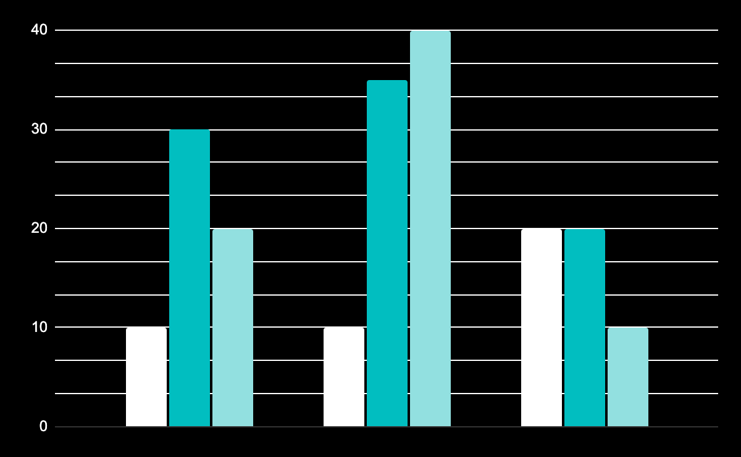
RESULTS ANALYSIS
VENUS
mars
5,408
9,150
It’s the second
It’s a cold place
jupiter
November
December
January
1,138
To modify this graph, click on it, follow the link, change the data and paste the new graph here
It’s a big planet

Slide 16
BIBLIOGRAPHICAL REFERENCES
● AUTHOR (YEAR). Title of the publication. Publisher ● AUTHOR (YEAR). Title of the publication. Publisher ● AUTHOR (YEAR). Title of the publication. Publisher ● AUTHOR (YEAR). Title of the publication. Publisher ● AUTHOR (YEAR). Title of the publication. Publisher ● AUTHOR (YEAR). Title of the publication. Publisher ● AUTHOR (YEAR). Title of the publication. Publisher

Slide 17
SECTION
03
You can enter a subtitle here if you need it

Slide 18

THE TITLE GOES HERE
Do you know what helps you make your point clear? Lists like this one:
They’re simple
You can organize your ideas clearly
You’ll never forget to buy milk!
And the most important thing: the audience won’t miss the point of your presentation

Slide 19
3,000
590,000
Mercury is the closest planet to the Sun
Venus has a beautiful name, but it’s hot

Slide 20
1,000,500
Big numbers catch your audience’s attention

Slide 21

AN IMAGE IS WORTH A THOUSAND WORDS

Slide 22
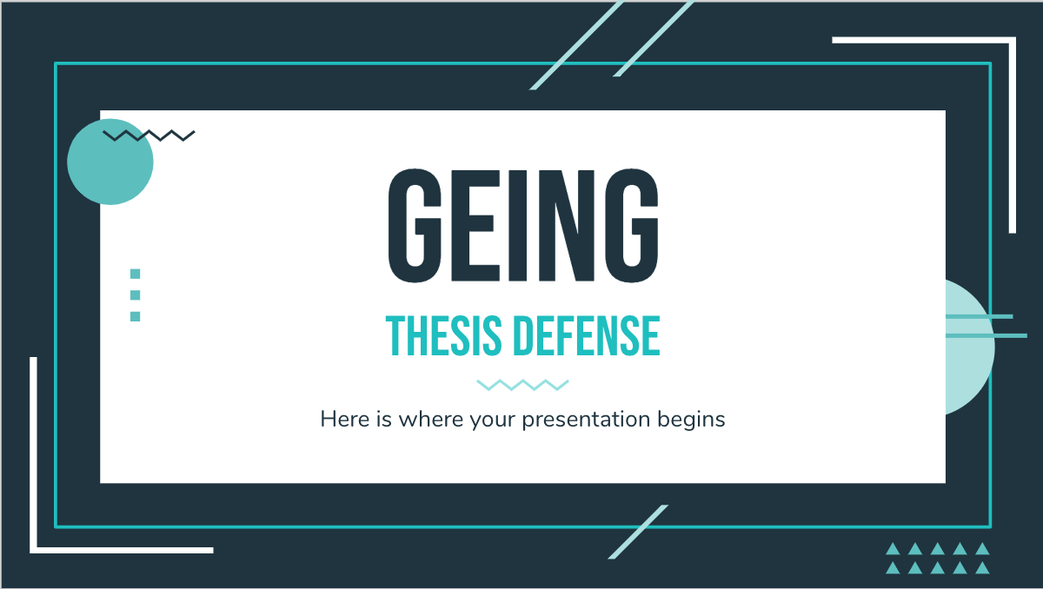
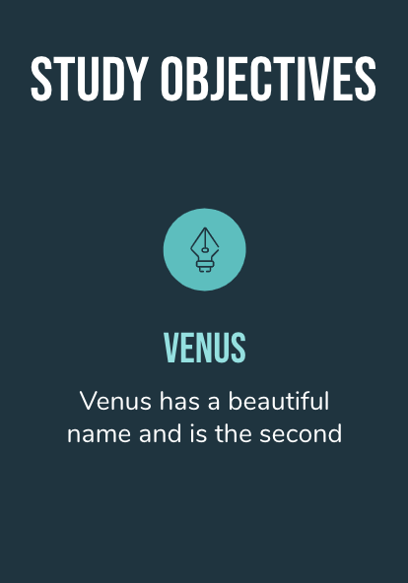
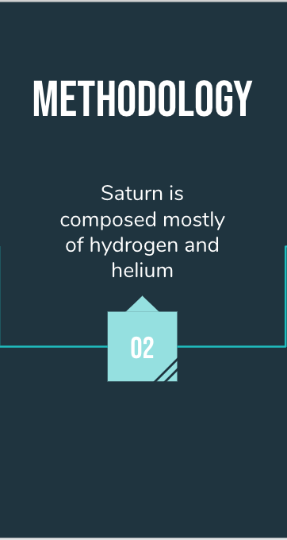
MY WEB
You can replace the images on the screens with your own work. Just delete these, add yours and and place them in the center of the respective device

Slide 23
THIS IS A MAP
mercury
mars
Mercury is the closest planet to the Sun
Despite being red, Mars is a cold place

Slide 24
REVIEWS
mercury
venus
mars
jupiter
saturn
neptune
It’s the smallest planet in the Solar System
It’s the second planet from the Sun
Despite being red, Mars is a cold place
It’s the biggest planet in the Solar System
Saturn is a gas giant and has several rings
It’s the farthest planet from the Sun

Slide 25
TIMELINE
Despite being red, Mars is very cold
Jupiter is the biggest planet
2002
2004
Venus is the second planet
Saturn is a total gas giant
2003
2005

Slide 26
AWESOME WORDS

Slide 27
OUR TEAM
TIMMY JIMMY
ANNE MCKANE
HELENA PATTERSON
Here you could talk a bit about this person
Here you could talk a bit about this person
Here you could talk a bit about this person

Slide 28
THANKS!
Do you have any questions?
youremail@freepik.com
+91 620 421 838
yourcompany.com
Please, keep this slide for the attribution

Slide 29
ALTERNATIVE RESOURCES

Slide 30
RESOURCES
vectors
Geometrical background with flat shapes
photos
Beautiful young woman sitting on chair reading book
Pile of books and clock

Slide 31
Instructions for use (free users)
In order to use this template, you must credit Slidesgo by keeping the Thanks slide.
You are allowed to:
Modify this template.
Use it for both personal and commercial purposes.
You are not allowed to:
Sublicense, sell or rent any of Slidesgo Content (or a modified version of Slidesgo Content).
Distribute this Slidesgo Template (or a modified version of this Slidesgo Template) or include it in a database or in any other product or service that offers downloadable images, icons or presentations that may be subject to distribution or resale.
Use any of the elements that are part of this Slidesgo Template in an isolated and separated way from this Template.
Delete the “Thanks” or “Credits” slide.
Register any of the elements that are part of this template as a trademark or logo, or register it as a work in an intellectual property registry or similar.
For more information about editing slides, please read our FAQs or visit Slidesgo School:
https://slidesgo.com/faqs and https://slidesgo.com/slidesgo-school

Slide 32
Instructions for use (premium users)
In order to use this template, you must be a Premium user on Slidesgo.
You are allowed to:
Modify this template.
Use it for both personal and commercial purposes.
Hide or delete the “Thanks” slide and the mention to Slidesgo in the credits.
Share this template in an editable format with people who are not part of your team.
You are not allowed to:
Sublicense, sell or rent this Slidesgo Template (or a modified version of this Slidesgo Template).
Distribute this Slidesgo Template (or a modified version of this Slidesgo Template) or include it in a database or in any other product or service that offers downloadable images, icons or presentations that may be subject to distribution or resale.
Use any of the elements that are part of this Slidesgo Template in an isolated and separated way from this Template.
Register any of the elements that are part of this template as a trademark or logo, or register it as a work in an intellectual property registry or similar.
For more information about editing slides, please read our FAQs or visit Slidesgo School:
https://slidesgo.com/faqs and https://slidesgo.com/slidesgo-school

Slide 33
Fonts & colors used
This presentation has been made using the following fonts:
Bebas Neue
(https://fonts.google.com/specimen/Bebas+Neue)
Nunito
(https://fonts.google.com/specimen/Nunito)
#1e343f
#01bec0
#92e0e0

Slide 34
Stories by Freepik
Create your Story with our illustrated concepts. Choose the style you like the most, edit its colors, pick the background and layers you want to show and bring them to life with the animator panel! It will boost your presentation. Check out How it Works.
Pana
Amico
Bro
Rafiki
Cuate

Slide 35
Use our editable graphic resources...
You can easily resize these resources without losing quality. To change the color, just ungroup the resource and click on the object you want to change. Then, click on the paint bucket and select the color you want. Group the resource again when you’re done. You can also look for more infographics on Slidesgo.

Slide 38
JANUARY
FEBRUARY
MARCH
APRIL
MAY
JUNE
PHASE 1
Task 1
Task 2
PHASE 2
Task 1
Task 2
JANUARY
FEBRUARY
MARCH
APRIL
PHASE 1
Task 1
Task 2

Slide 41
...and our sets of editable icons
You can resize these icons without losing quality.
You can change the stroke and fill color; just select the icon and click on the paint bucket/pen.
In Google Slides, you can also use Flaticon’s extension, allowing you to customize and add even more icons.

Slide 42
Educational Icons
Medical Icons

Slide 43
Business Icons
Teamwork Icons

Slide 44
Help & Support Icons
Avatar Icons

Slide 45
Creative Process Icons
Performing Arts Icons

Slide 46
Nature Icons

Slide 47
SEO & Marketing Icons

Slide 48


